Slide 1

The GOLD Care Africa
Palliative Care Series
Dr Ian Kibet

Slide 2
Objectives of This Session
• Define palliative and end-of-life care
• Understand the scope of palliative care needs
• Introduce GOLD Care Africa Pilot
Notes:
Outline what participants should gain from the session.

Slide 3
What is Palliative Care?
WHO Definition
Palliative care is an approach that improves the quality of life of patients and their families facing the problems associated with life-limiting and life-threatening illness, through the prevention and relief of suffering by means of early identification and impeccable assessment and treatment of pain and other problems, physical, psychosocial, and spiritual.
Notes:
It is not a complicated concept. It is just good medicine for those who are most vulnerable

Slide 4

Elements of Palliative Care?
Provides relief from pain and other distressing symptoms
Affirms life and regards dying as a normal process
Intends neither to hasten nor postpone death
Integrates psychological and spiritual aspects of care
Offers a support system to help patients live as actively as possible until death
Offers a support system to help families cope during the patient’s illness and in bereavement
Uses a team approach to address patient and family needs
Is applicable early in the course of illness, alongside therapies intended to prolong life
Notes:
Explain WHO definition and stress early integration, not just terminal care.

Slide 5
What Palliative Care Is Not
• Not giving up
• Not stopping treatment
• Not only for cancer
• Not only last days
Notes:
Correct common misconceptions seen in daily practice.

Slide 6

Other Key Definitions
End-of-Life Care (EoL Care)
Care provided to patients who are likely to die within the next 12 months, with increasing intensity in the last weeks or days of life.
This is the focus of GOLD Care Africa
Notes:
Clarify EoL as a subset of palliative care.

Slide 7
Supportive Care
An approach to care that focuses on relieving symptoms, improving function, and supporting quality of life, with or without ongoing disease-directed treatment.

Slide 8
Hospice Care
A model of care focused on comfort rather than cure, usually provided when a patient is thought to be in the last months of life and disease-directed treatment has been stopped

Slide 9
Feature | Hospice Care | Supportive Care
Main goal | Comfort at end of life | Symptom relief & quality of life
Timing | Last months of life | Any stage of illness
Curative treatment | Stopped | May continue
Prognosis required | Yes | No
Setting | Hospice / home | Any care setting
Focus | Dying well | Living well with illness

Slide 10

Life-Threatening Illness
A condition that may be curable but carries a significant risk of death.
Examples
Severe infections
Complicated HIV
Some Cancers

Slide 11
Life-Limiting Illness
A condition that cannot be cured and is likely to shorten a person’s life.
Examples
Advanced cancer
End-stage heart, lung, kidney, or liver disease

Slide 12
Advance Care Planning (ACP)
A process of ongoing conversations in which patients (and families) express their values, preferences, and goals for future medical care.
May include
Preferred place of care or death
Limits of treatment (e.g. ICU, dialysis, resuscitation)

Slide 13

Goals of Care
Clear, shared understanding of what matters most to the patient at this time and how treatment should be aligned with those goals.
Shared and Informed decision making between clinical teams and patients and their families
Examples:
Comfort over longevity

Slide 14
Key Challenges in End-of-Life Care
Unpredictable disease trajectories
Periods of stability & decline
Late recognition of dying
Reactive instead of proactive approach
Avoidance of Palliative care and End-of-Life Discussions
Notes:
Introduce care trajectories concept.

Slide 15
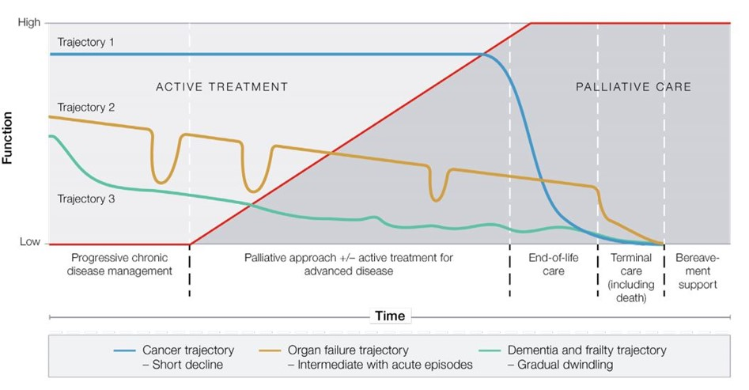
Care Trajectories Diagram
Notes:
Cancer – predictable decline
Organ failure – ups and downs
Frailty/dementia – slow decline

Slide 16
Palliative Care in Kenya
“Palliative care is often misunderstood as care only for dying patients or hospice care, leading to late referrals and underutilization of supportive care approaches.” Mavumba, R. W. (2021)
800,000 Kenyans need palliative care yearly, rising NCD and chronic disease burden (Cartmell et al., 2023)
<2% receive it
Notes:
Highlight national gap and urgency.

Slide 17
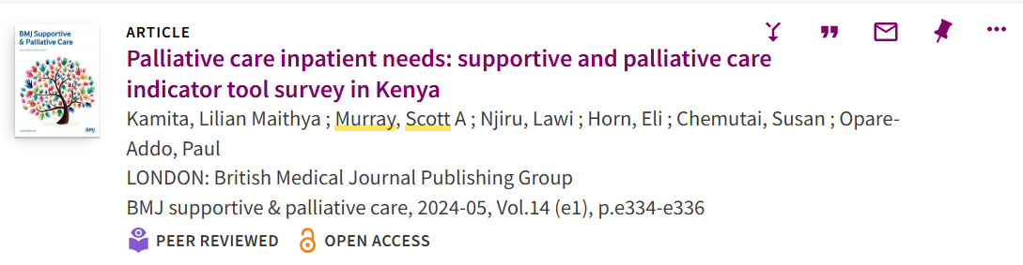
Palliative Care Needs in Chogoria
A SPICT Survey showed that 33 percent of patients in medical and surgical wards at Chogoria Hospital have palliative care needs, but only 10 percent had them documented.
Notes:
Many elderly & NCD patients
Advanced HIV & cancer
Late EoL recognition

Slide 18
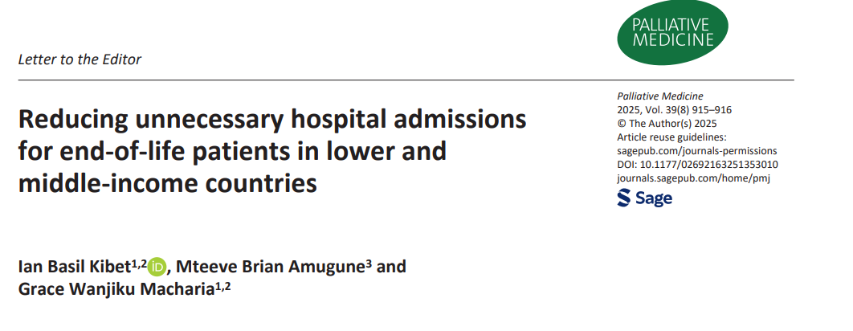
Are all inpatient stays for end-of-life patients necessary?

Slide 19
What Is Gold Standard Framework?
Structured approach to identify and care for patients in the last year of life
Supports generalist clinicians to provide palliative care to end-of-life patients.
Has been endorsed by the UK Department of Health and adopted by over 25 percent of care homes in the UK
Notes:
Introduce Gold Standards Framework.

Slide 20
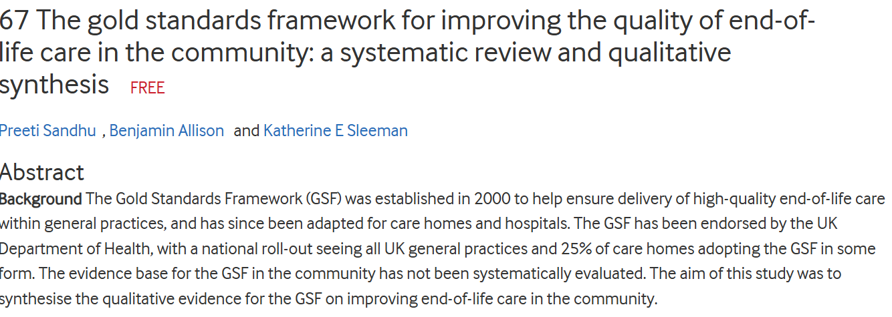
The Impact of GSF in the UK
Notes:
https://spcare.bmj.com/content/9/Suppl_1/A33.2

Slide 21

Professor Keri Thomas- Founder of GSF and Professor of End-of-Life Care.

Slide 22
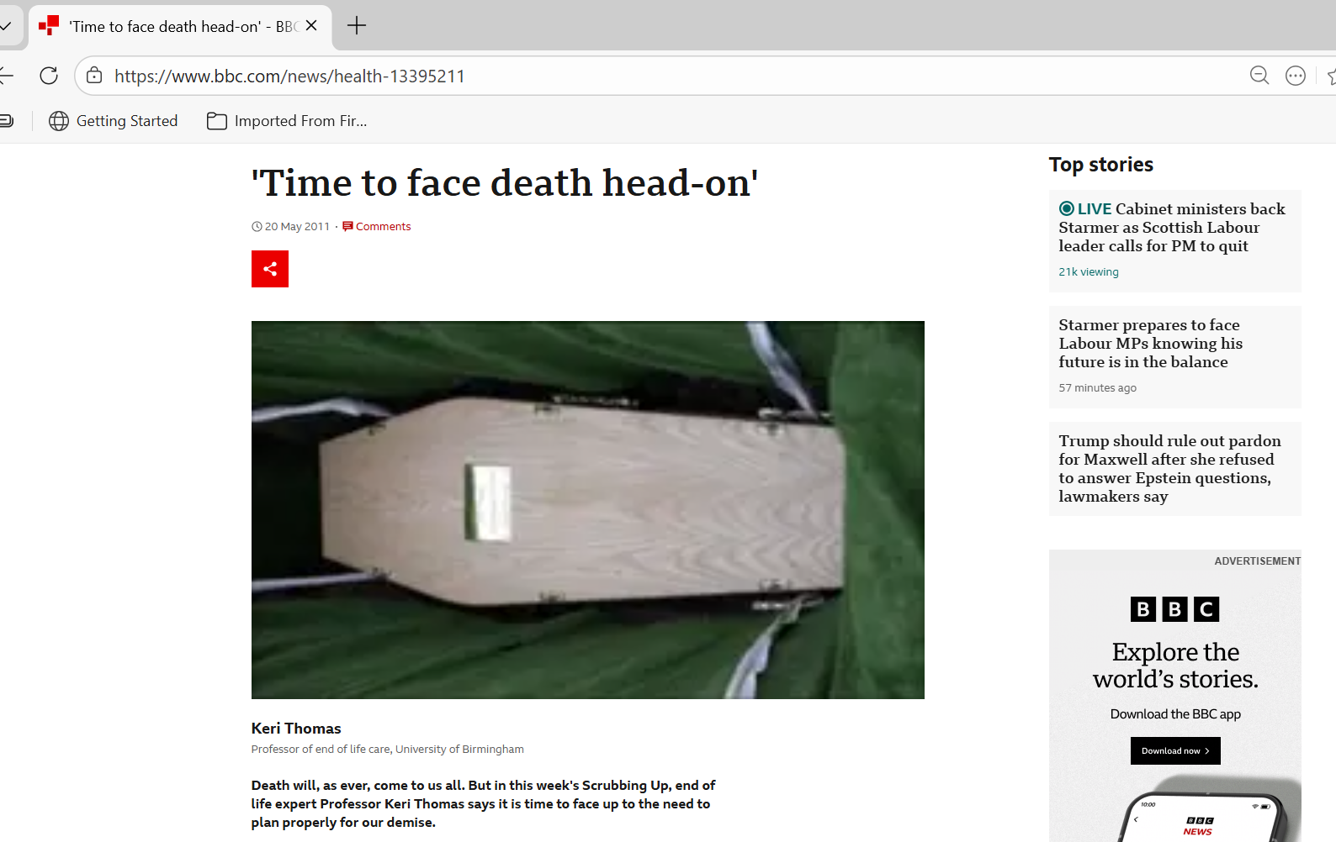
Death is not the enemy; a bad death is….

Slide 23
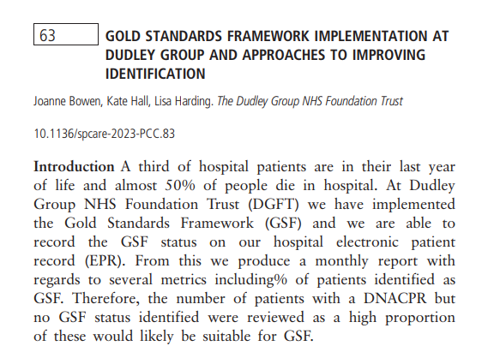
The Exciting Part…
To honor her late husband, Andrew Rodger, who died in Africa, Prof Keri decided to support three African Hospitals to pilot GOLD Care in Africa.
We applied as PCEA Chogoria and were selected
We are now set to be the first GOLD Certified Hospital in Africa
Notes:
Powerful clinical trigger question.

Slide 24
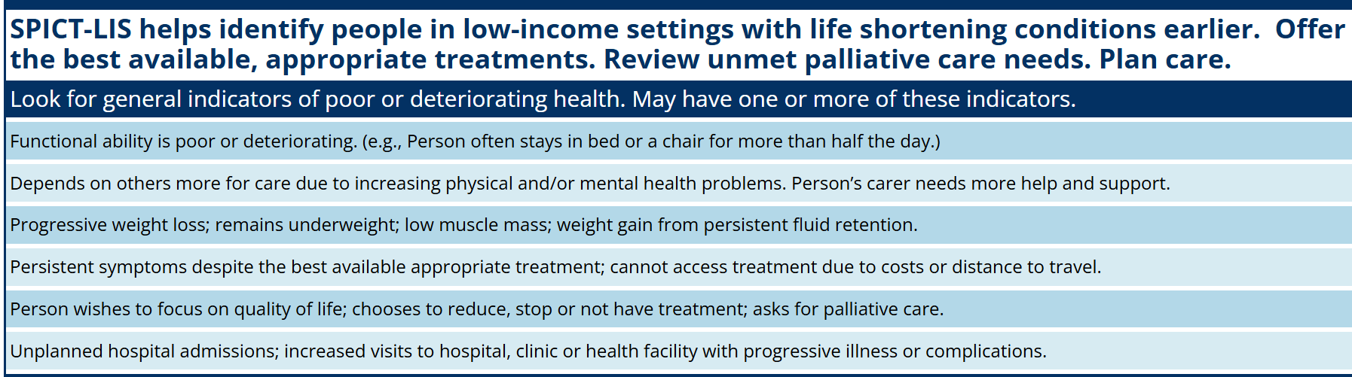
How Do We Identify a Patient at the End of Life
Notes:
Plus surprise question

Slide 25
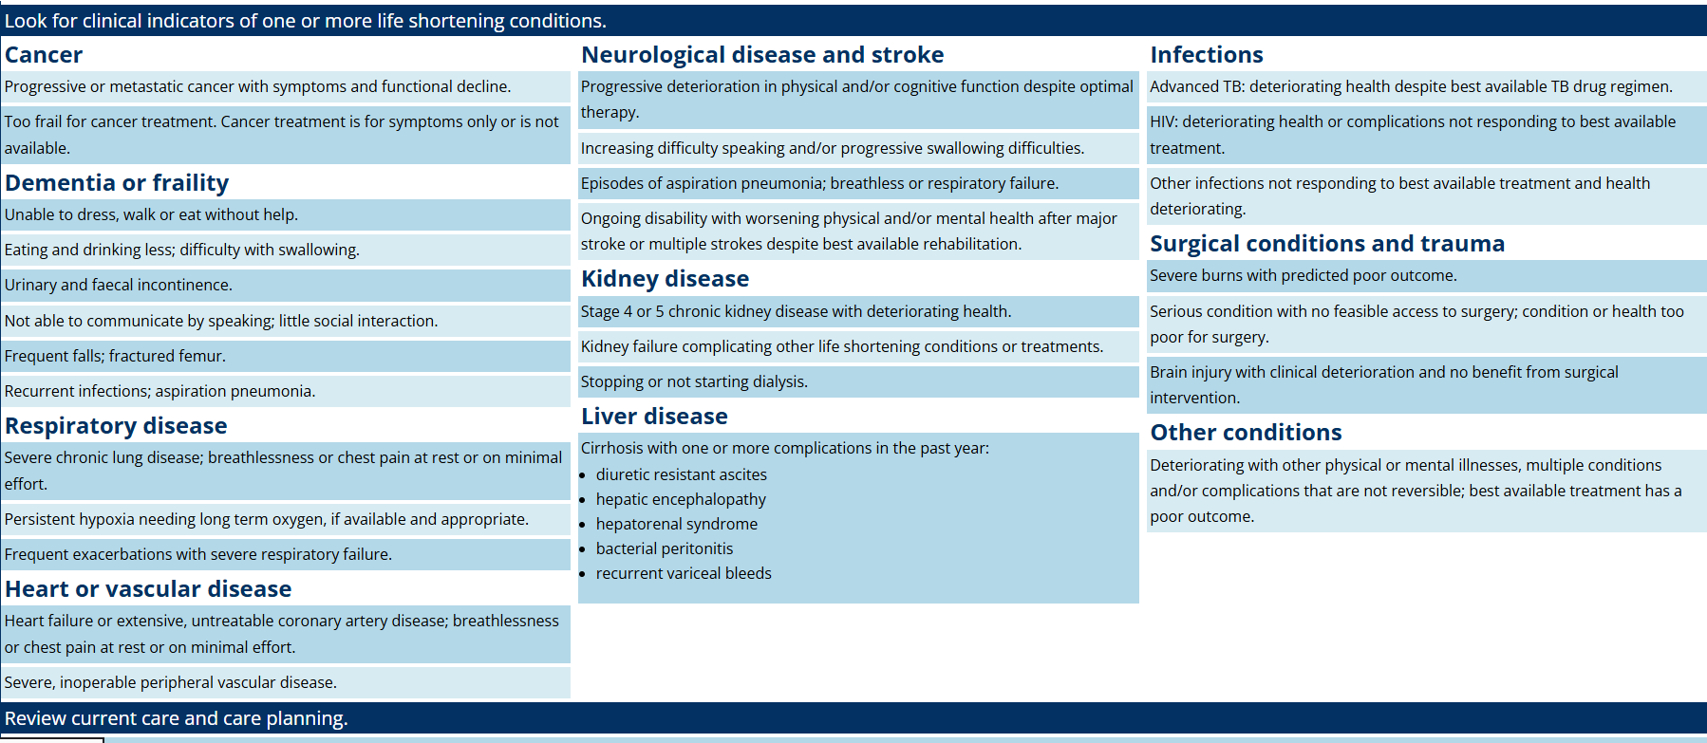
Disease-Specific Feature of Deterioration- SPICT

Slide 26
GOLD Care AFRICA?
What?- Train Generalist staff to identify end-of-life patients.
So What?- To ensure all patients in the Medical Wards are appropriately coded based on their disease trajectory
Now What? – To ensure all patients at the end of life, “GOLD PATIENTS” are identified and offered proactive end-of-life care to make their experience as humane as possible.
Notes:
Explain package of care once identified.

Slide 27
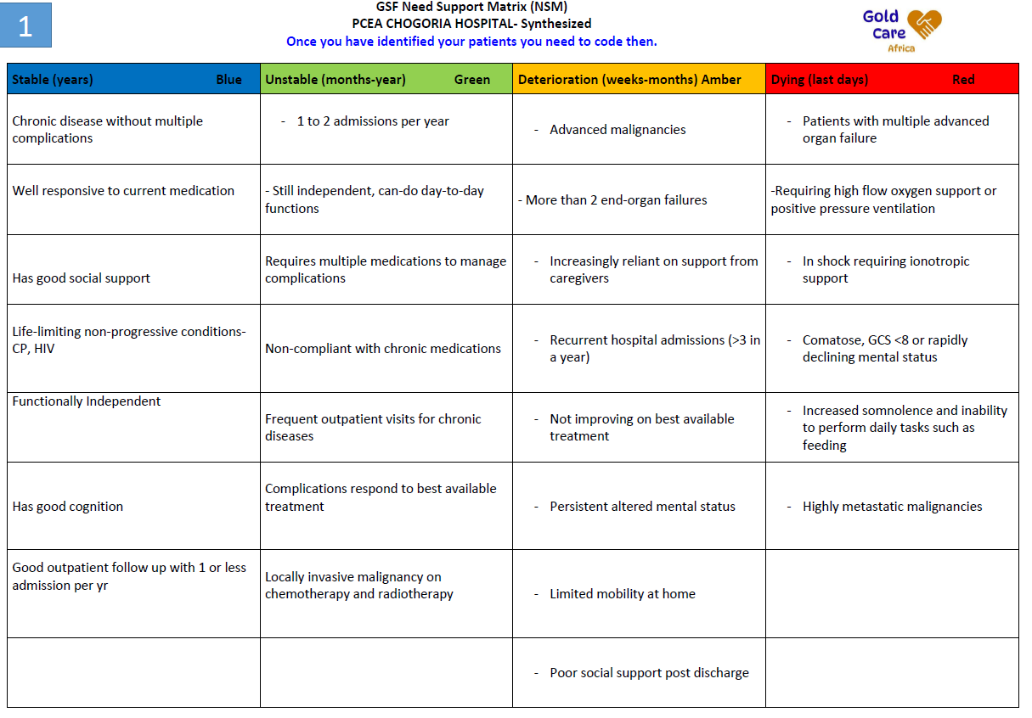
RED- AMBER- GREEN-BLUE CODES

Slide 28
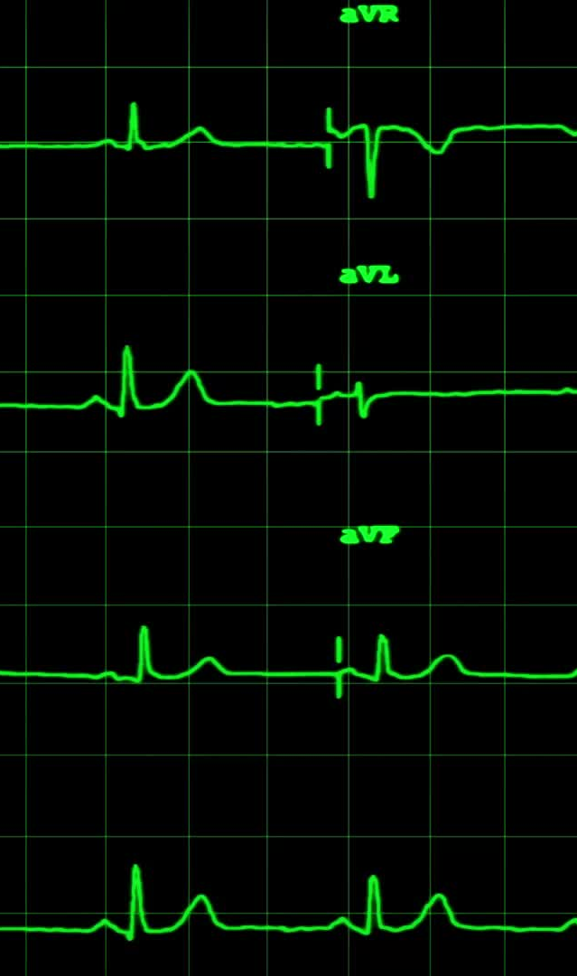
Clinical Scenario 1: Coding in Practice
78-year-old with dementia, heart failure & ESRD
4 admissions in 12 months
Now saturating at 78 percent on 15L NRM, anuric, family declined dialysis
Notes:
Teaching script: This patient has multiple advanced organ failure, is not responding to treatment, and is actively dying. This is RED. Response: focus on comfort, relieve breathlessness, opioids if needed, oxygen for comfort, no escalation, family presence, dignity.

Slide 29
RED
This patient has multiple advanced organ failures with more than 3 admissions in a year. He is not responding to treatment and is actively dying. This is RED. Response: Family conference for DNR/DNI status, focus on comfort, relieve breathlessness, oxygen for comfort, no escalation, family presence, spiritual support, dignity.

Slide 30
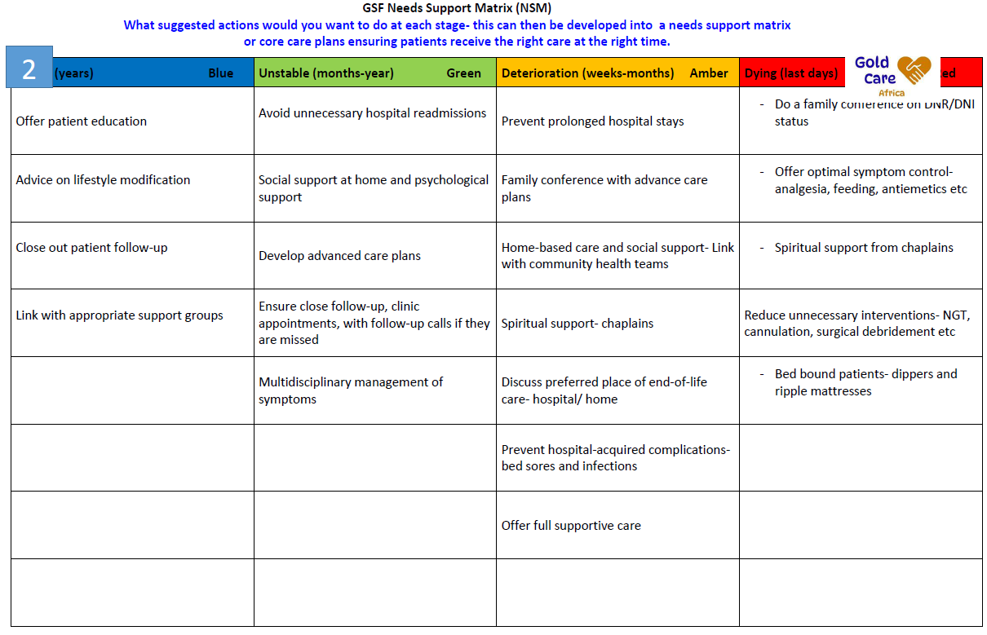
Not for prognostication but for needs assessment

Slide 31
Clinical Scenario 2: Coding in Practice
56-year-old with metastatic prostate cancer
Quadriplegic, incontinent, bed-bound
On hormonal therapy, no acute complications

Slide 32
GREEN
This patient has an advanced malignancy but is currently not deteriorating. Prostate CA may have an indolent clinical course, with a prognosis of a year or more. This is GREEN. Response: advance care planning, pain control, prevent new complications, e.g., DVT and pressure sores, good clinic follow-up, minimize unnecessary admissions, and do community linkage.

Slide 33
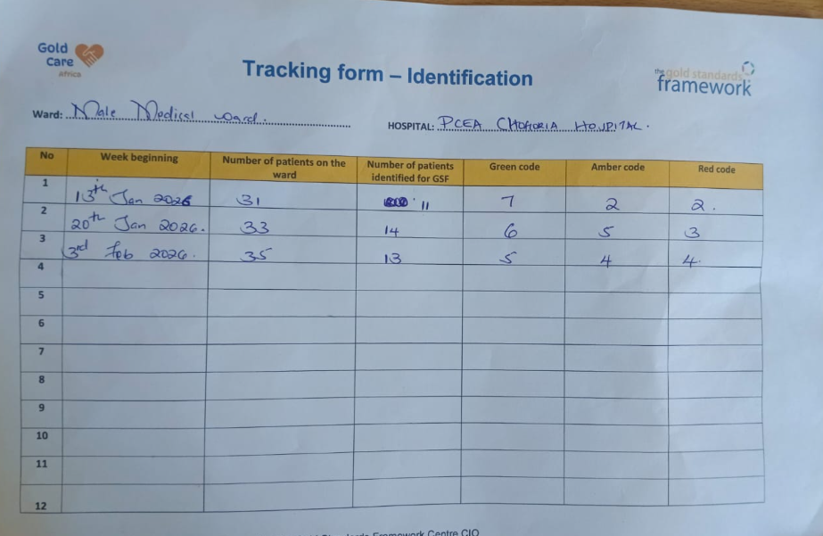
What is Needs-Based Coding?

Slide 34
Clinical Scenario 3: Coding in Practice
68-year-old chronic smoker with COPD
≥3 exacerbations in 12 months requiring admission
Poor response to LABA+LAMA+ICS inhaler, steroid dependent, now on home oxygen

Slide 35
AMBER
This patient shows clear deterioration and escalating needs. He is not responding to the best available treatment. This is AMBER. Response: optimize symptoms, discuss goals of care, prevent further admissions, and prepare the family for decline. Link the family to the community team upon discharge for home-based support (such as reducing smoke exposure).

Slide 36
Why Identify GOLD Patients?
A modest grant has been allocated to support patients identified as GOLD, with priority given to those under the AMBER code.
So far, we are planning the following:
All bed-bound GOLD patients will receive free ripple mattresses.
Incontinent GOLD patients will receive free diapers.
Facilitation of home visits with the community team. Essential shopping may be provided based on the patient’s needs.
The grant is not intended to cover clinical expenses or medications, except in very special circumstances.
If any coded patient in the ward has a pressing need that may be supported by this grant, kindly let us know

Slide 37
After Identification
The patient’s code should appear in the notes
A family conference should be set up for GOLD patients
Advance Care Plans and DNR/DNI status should be clearly documented.
Discharged patients will be linked with the community team led by RCO Dickson Fundi to support home-based interventions

Slide 38
For GOLD Care to Work;
Strong multidisciplinary framing
Doctors / MOs / Interns/ Residents
Nurses
Nutritionists
Social workers
Community health teams / RCOs
Oncology team

Slide 39
A Holistic Approach to GOLD Patients
Physical support- pain control, feeding and nutritional support, mobilization and turning, ripple mattresses, symptom control, medication rationalization.
Psychosocial care- Mental Health support, anxiety and depression screening, acknowledging and addressing family distress, and caregiver support.
Spiritual care- Chaplain reviews, discuss source, meaning, and purpose of life, dignity, faith, salvation status, and understanding of the afterlife.

Slide 40
It is a Pilot…. Learning, Unlearning, and Relearning
This project is being implemented as a pilot, meaning it is a careful introduction of new concepts to assess feasibility, safety, and acceptability before full scale-up.
The pilot will run for two years, with the first year limited to the adult medical wards and community follow-up.
During this phase, end-of-life coding will be used internally by clinical teams and documented only in patient notes to guide proactive care and ensure continuity, without being disclosed to patients.
This approach is intended to protect patients and families while staff skills and systems are strengthened.
Following successful evaluation of the pilot, additional GOLD Care components will be introduced, including greater patient involvement, discussion of preferences for place of care and death, and expansion to other wards.
Notes:
Affirm institutional strengths.

Slide 41

Any practicing clinician can identify a patient approaching death.
GOLD Care is simply good medicine for the most vulnerable.

Slide 42
First GOLD Care Certified Hospital in Africa…
Leadership opportunity
Continental learning hub
Thank you
Notes:
Create pride and motivation.

Slide 43
References
Afolabi, O. A., Nkhoma, K., Maddocks, M., & Harding, R. (2021). What constitutes a palliative care need in people with serious illnesses across Africa? A mixed-methods systematic review of the concept and evidence. Palliative Medicine, 35(6), 1052-1070.
Bergenholtz, H., Weibull, A., & Raunkiær, M. (2022). Supportive and palliative care indicators tool (SPICT™) in a Danish healthcare context: translation, cross-cultural adaptation, and content validation. BMC Palliative Care, 21(1), 41.
Cartmell, K. B., Doherty, E. A., Gikaara, N., Ali, Z., Qanungo, S., Melikam, E. S., & Powell, R. A. (2023). Kenyan palliative care providers' and leaders' perceptions of palliative care research needs and support to facilitate rigorous research. BMC Palliative Care, 22(1), 1–11. https://doi.org/10.1186/s12904-023-01199-0
Conroy, S., & Banerjee, J. (2012). Silver Book.
Gans, D., Hadler, M. W., Chen, X., Wu, S. H., Dimand, R., Abramson, J. M., ... & Kominski, G. F. (2015). Impact of a pediatric palliative care program on the caregiver experience. Journal of Hospice & Palliative Nursing, 17(6), 559–565. https://doi.org/10.1097/NJH.0000000000000203
Kamita, L. M., Murray, S. A., Njiru, L., Horn, E., Chemutai, S., & Opare-Addo, P. (2024). Palliative care inpatient needs: supportive and palliative care indicator tool survey in Kenya. BMJ Supportive & Palliative Care, 14(e1), e334-e336.
Mavumba, R. W. (2021). Knowledge, attitude, practice and barriers to service delivery of paediatric palliative care amongst health care practitioners at Kenyatta National Hospital. Doctoral Dissertation University of Nairobi, 1–69.
Shaw, K. L., Clifford, C., Thomas, K., & Meehan, H. (2010). Improving end-of-life care: a critical review of the Gold Standards Framework in primary care. Palliative Medicine, 24(3), 317-329.
Shepperd, S., Gonçalves-Bradley, D. C., Straus, S. E., & Wee, B. (2021). Hospital at home: home‐based end‐of‐life care. Cochrane Database of Systematic Reviews, (3).
Thomas, K., Armstrong-Wilson, J., & Clifford, C. (2022). The Gold Standards Framework hospital programme: implementation and progress. International Journal of Palliative Nursing, 28(4), 172-177.
Thoonsen, B., Groot, M., Engels, Y., Prins, J., Verhagen, S., Galesloot, C., ... & Vissers, K. (2011). Early identification of and proactive palliative care for patients in general practice, incentive and methods of a randomized controlled trial. BMC family practice, 12(1), 123.

